Slide 1




22 KHMT 1
MathLLM
Introduction to Machine Learning
GROUP 01

Slide 2


Contents
About us
Problem Statement
Datasets
Original Model
Fine-tuning
Evaluation
Website Application

Slide 3
About Us
22127032 - Nguyễn Thiên Bảo
22127220 - Nguyễn Anh Kiệt
22127275 - Trần Anh Minh
22127280 - Đoàn Đặng Phương Nam
22127253 - Cao Minh Quang

Slide 4
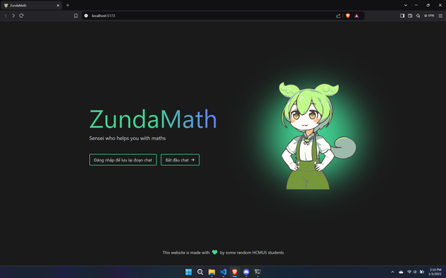

Problem Statement
Challenge
MathLLM
Personalized assistance
Contraints in time and resouces of teachers
Understanding struggle within students
Assist with elementary and secondary math
Provide accurate answers
Step by step explanation

Slide 5
Datasets
Orca Math Word Problems
Vietnamese Intermediate Reality Math Problems
Compiled by our team
Vietnamese context
More complex mathematical problems
Develop by Microsoft
English context
Basic mathematics queries
The translated Orca dataset establishes a foundational understanding of basic math, while the Vietnamese one enhances the model’s ability to tackle challenges

Slide 6
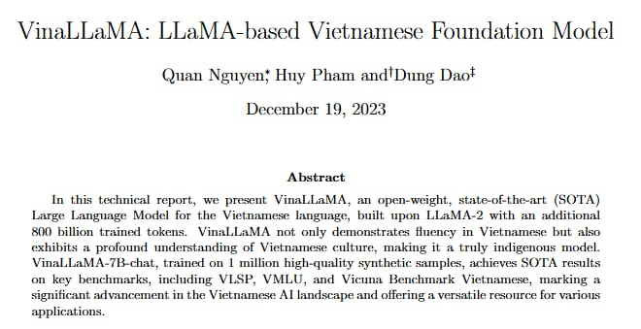
Original Model
Source: https://arxiv.org/abs/2312.11011

Slide 7
VinaLLaMA-7b-chat
Based on LLaMA-2 architecture, pre-trained with over 800 billion tokens
Optimized for Vietnamese and support English
Utilizes a diverse range of public datasets and high-quality synthetic data source
Performance is closely competitive with ChatGPT-3.5-Turbo
Source: https://arxiv.org/abs/2312.11011

Slide 8
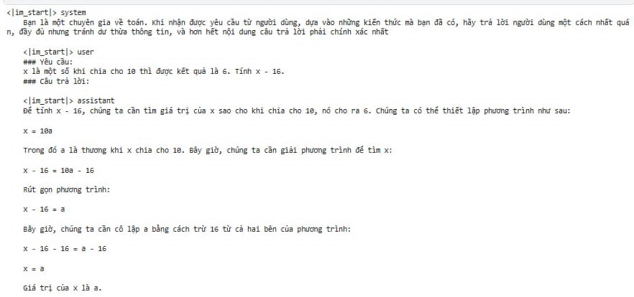
Before and After Fine-Tuning
Before Fine-Tuning
Cannot do correctly

Slide 9
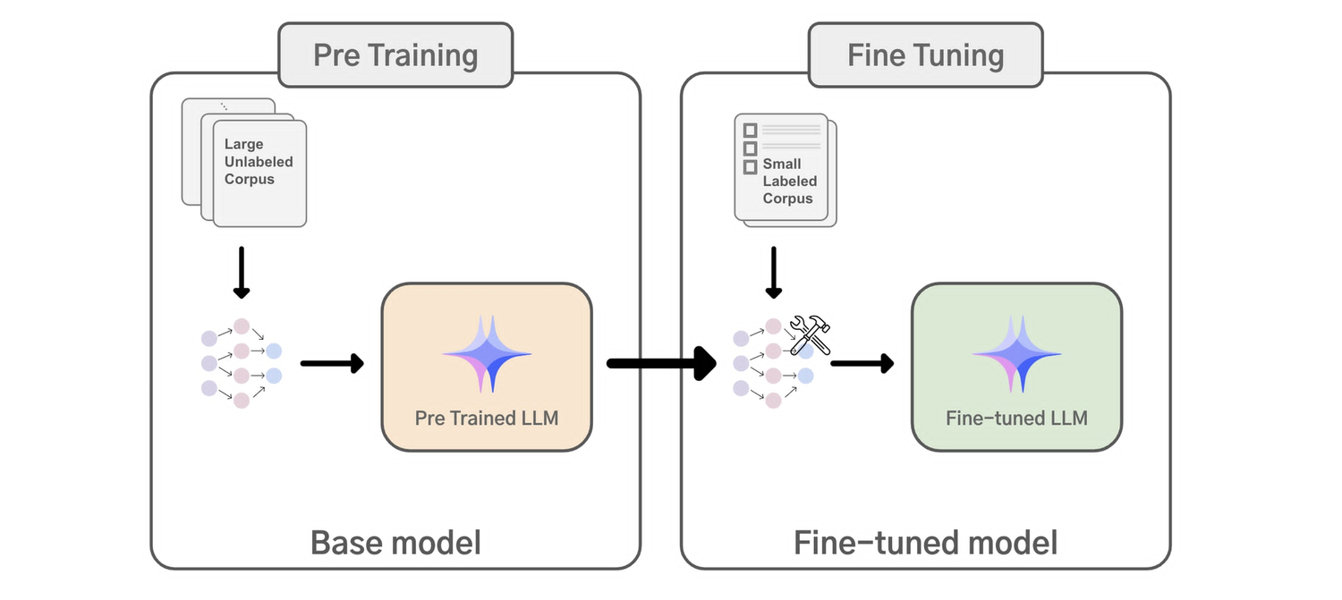
Fine Tuning
What is Fine Tune?
Adjusting a pre-trained model’s weight on a specific task or dataset to improve performance.

Slide 10
Fine Tuning
What is Fine Tune?
Adjusting a pre-trained model’s weight on a specific task or dataset to improve performance.
From Fine-Tuning to PEFT (Parameter-Efficient Fine-Tuning)
Goal: Achieve fine-tuning efficiency by updating only a subset of model parameters.
Key techniques:
Adapter Tuning: Inserts small modules into the model, training them while keeping core layers frozen.
LoRA (Low-Rank Adaption): Adds trainable low-rank matrices to model layers.
Benefits: lower resource requirements, faster training.
QLoRA (Quantized LoRA)
Combines 4-bit quantization with LoRA for efficient fine-tuning.
Optimizing large-scale models for resource-constrained environments.

Slide 11
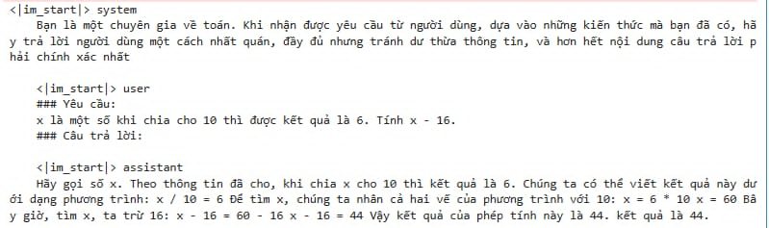
Before and After Fine-Tuning
After Fine-Tuning

Slide 12
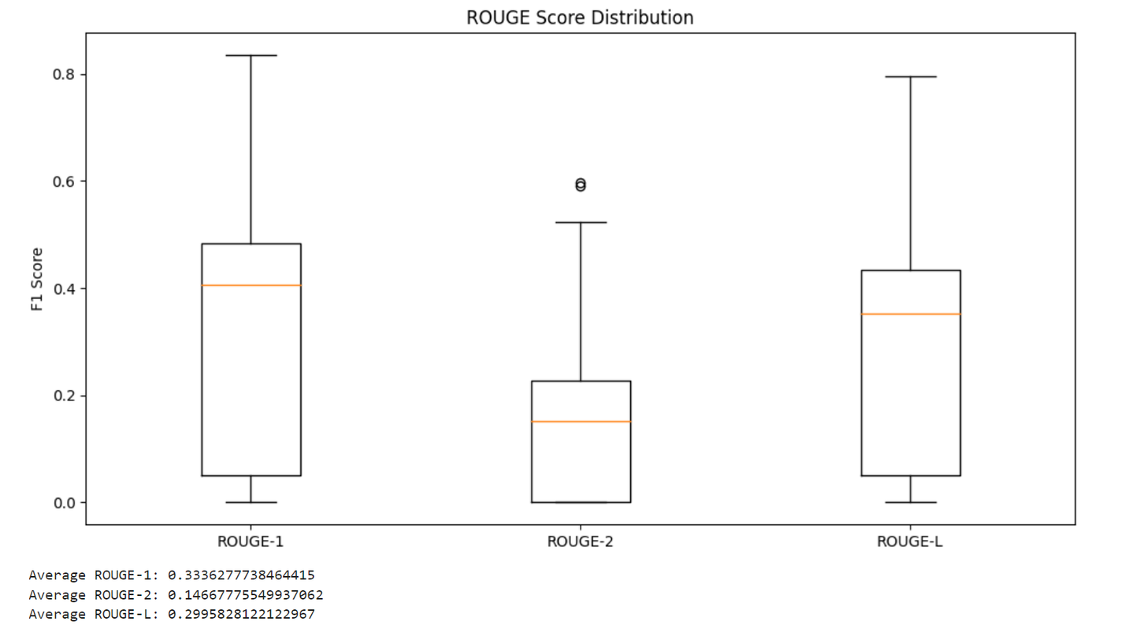
Evaluation
Original Model

Slide 13
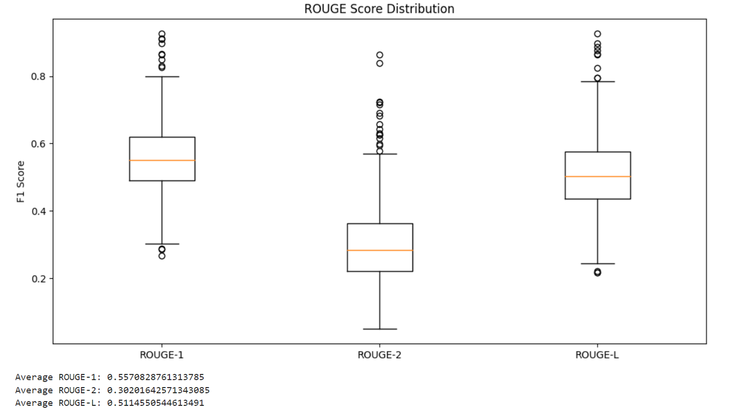
Evaluation
MathLLM

Slide 14
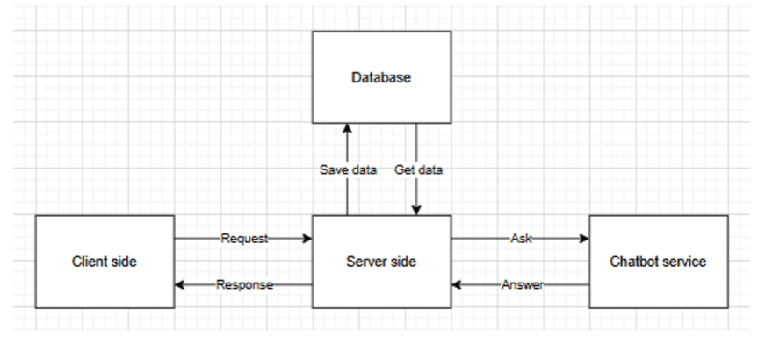
Web Aplication

Slide 15
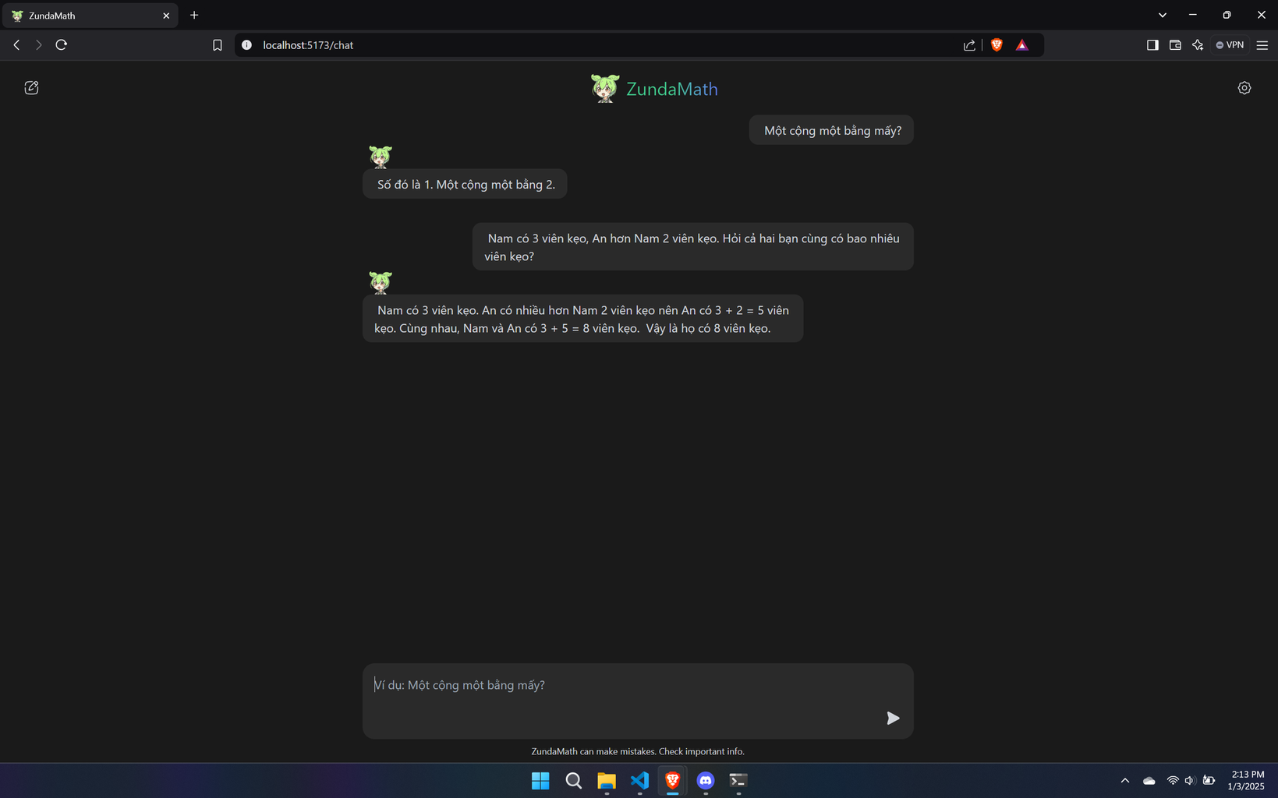
Web Aplication

Slide 16

Thank You
Group 01
Group 01
22KMT1, HCMUS

